Slide 1
Testing

Slide 2
Lesson Objectives
Discuss the importance of a complete test suite
Define the differences between unit, integration, and end-to-end testing
Create unit tests to achieve a specified code coverage level
Utilize fixtures and mocks to implement unit tests

Slide 3
Why Test?
Why is testing important?

Slide 4
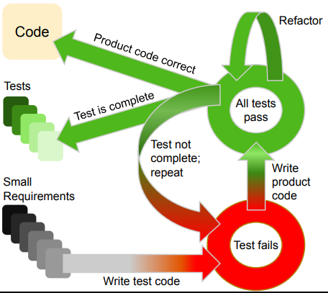
Test Driven Development
Different mindset of software development
Requirements → tests → code
Typically done in red-green-refactor phases
Write a failing test
Write code until the test passes
Refactor the code to cleanup

Slide 5
Testing Types
Functional
Unit tests
Integration tests
End-to-end tests
Acceptance
Non-functional
Security
Performance
Usability
Compatibility

Slide 6
Unit Tests

Slide 7
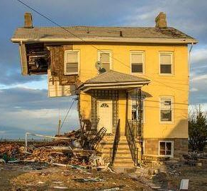
Unit Testing
Is your house stable if the lumber is rotted?
Smallest piece of testable code : unit
Benefits
Helps ensure correctness
Catch problems early
Fast

Slide 8
Unit Testing / Reqts. Framework
Given – When – Then
Given: The initial conditions / prerequisites
When: The action or event to be verified
Then: The outcomes of the action or event
Useful for formulating unit tests based on requirements
Used to communicate with non-technical stakeholders
Keep tests small!!

Slide 9
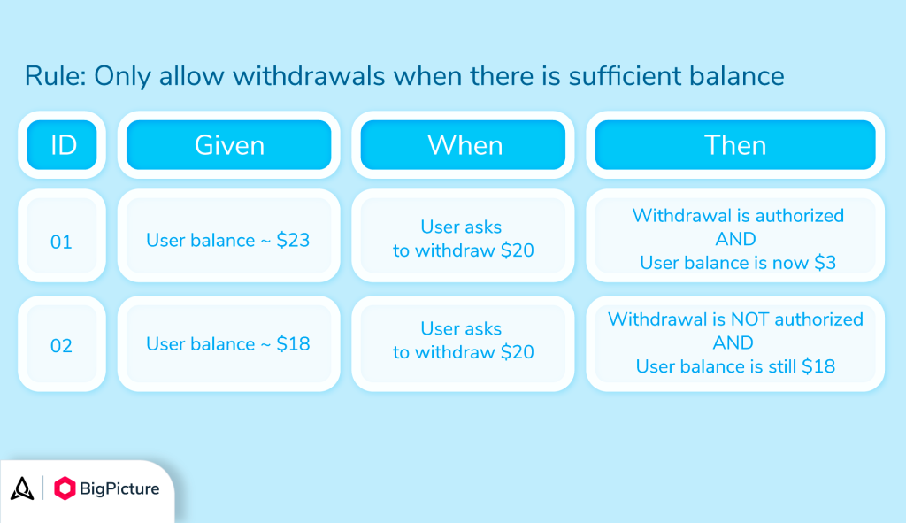

Slide 10
Testing in Python
def add(a, b):
return a + b
def test_add():
assert add(1, 2) == 3
assert add(0, 5) == 5
def test_add_negative():
assert add(-5, -7) == -12
assert add(-5, 5) == 0
Pytest / unittest / doctest
Each has their own pros/cons
Assert statement
Notes:
How would you write “given, when, then” for the code on the right?

Slide 11
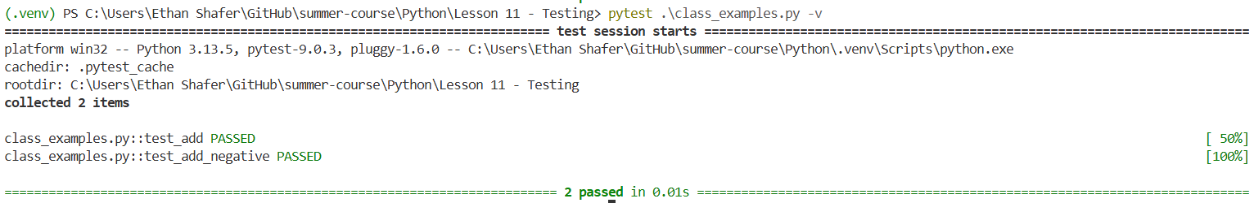
PyTest
def add(a, b):
return a + b
def test_add():
assert add(1, 2) == 3
assert add(0, 5) == 5
def test_add_negative():
assert add(-5, -7) == -12
assert add(-5, 5) == 0
A separate package / command
Generally auto-discovers tests
Can also give specific files

Slide 12
Pytest Example
Temperature conversion
Scenario 1
Given a temperature of 0C
When I convert to F
Then I should get 32F
Scenario 2
Given a temperature of 100C
When I convert to F
Then I should get 212F
Scenario 3
Given a temperature of -40C
When I convert to F
Then I should get -40F
Scenario 4
Given a temperature of -300C
When I convert to F
Then I should get an error!

Slide 13
Hands-On #1

Slide 14
Completeness
Code coverage

Slide 15
DRY
Fixtures

Slide 16
Mocking External References
Intro to mocks

Slide 17
Integration Tests

Slide 18
Integration tests

Slide 20
Questions

